Slide 1
Customer Churn Prediction Using Supervised Machine Learning
Churn: Yes
Churn: No
AI
Classification, KNN, Bagging, AdaBoost and Gradient Boosting
Presented by
D. Koteswara Rao
Notes:
This project predicts whether a telecom customer will leave the company, which is called churn. I used a customer dataset and cleaned it, explored it with graphs, and trained six machine learning models. I compared the models using Accuracy, Precision, Recall, F1 Score and cross-validation. Finally, I selected the best model and gave simple business recommendations.

Slide 2
Business Problem & Objective
What is customer churn?
A customer stops using the company's service and leaves.
Target variable: Churn
Yes
Customer may leave
Why predict churn?
Companies can find at-risk customers early and try to keep them before they leave.
No
Customer may stay
Project objective
Build a machine learning model that predicts whether a customer will churn or not.
Notes:
Customer churn means a customer stops using a company's service. Winning a new customer costs more than keeping an old one, so companies want to know who may leave early. My objective is to build a model that predicts churn. The target column is Churn, where Yes means the customer may leave and No means the customer may stay.

Slide 3
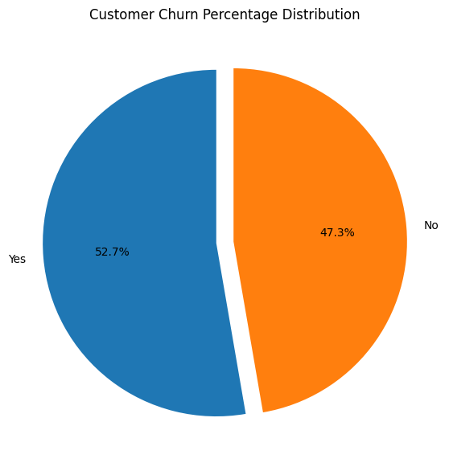
Dataset Understanding
184
Rows
13
Columns
Numerical (7): Age, Annual Income, Tenure, Monthly Charges, Support Calls, Data Usage, Satisfaction Score
Categorical (4): Contract Type, Payment Method, Region, Plan Type
Target: Churn (Yes / No). ID: Customer_ID (not used)
Data types: 6 float64, 7 object. Annual_Income loaded as text because of "?" values.
Yes: 97 (52.7%) | No: 87 (47.3%)
Notes:
The dataset has 184 rows and 13 columns, and it is messy on purpose, with missing values and wrong entries. It has 7 numeric features, 4 categorical features, a Customer ID and the target column Churn. Customer ID is not used for prediction. The target is almost balanced, with 97 customers who churned and 87 who stayed.

Slide 4
Data Cleaning & Preprocessing
Raw Data
Cleaning
Missing Values
Duplicates
Encoding
Scaling
ML Ready Data
Missing values
Found in 7 numeric columns (Age 8, Income 11...). Numeric: median. Categorical: most frequent.
Duplicates
4 exact duplicate rows removed: 184 to 180 rows.
Placeholders
N/A: 0, NA: 0, "?": 4 found. Treated as missing values.
Categorical cleaning
Spaces and capitals standardised (MONTHLY, monthly to Monthly).
Outlier check
IQR and box plots (Age 145, Monthly Charges 999). Investigated, not blindly deleted.
Encoding
One-Hot for Contract, Payment, Region, Plan. Churn: No = 0, Yes = 1.
Scaling
StandardScaler on 7 numeric features, fitted on training data only.
Train / Test split
80/20 stratified: 144 train, 36 test. 23 features after processing.
Notes:
First I checked the raw data for missing values, duplicates and placeholder values like question marks. Numeric missing values were filled with the median and categorical ones with the most frequent value. Four duplicate rows were removed, and outliers were investigated instead of blindly deleted. Then categories were one-hot encoded and numbers were scaled, giving ML-ready data.

Slide 5
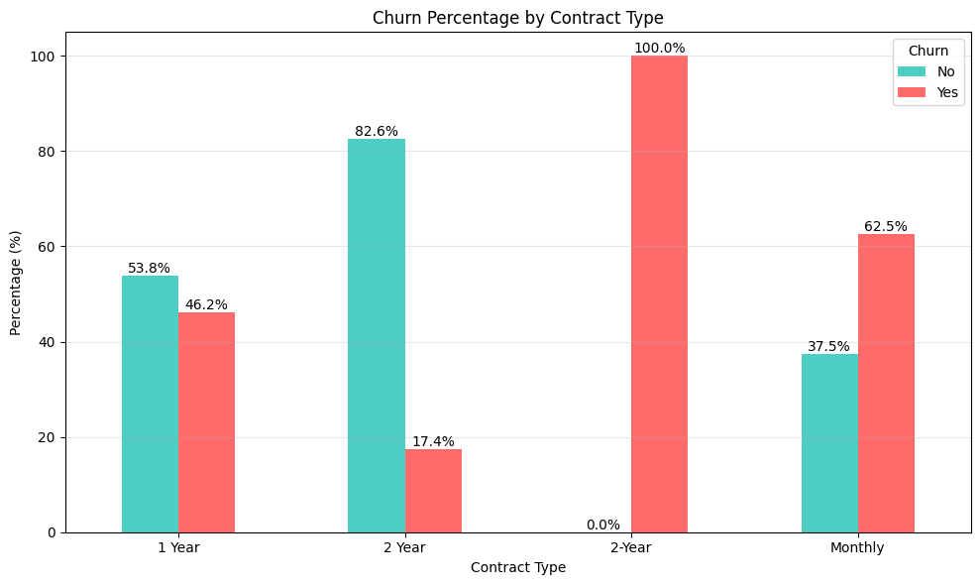
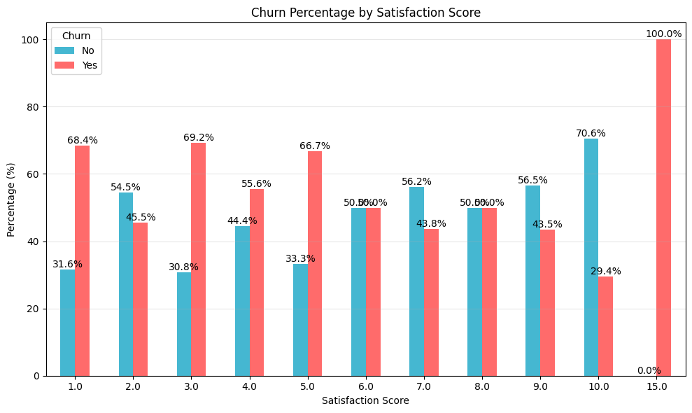
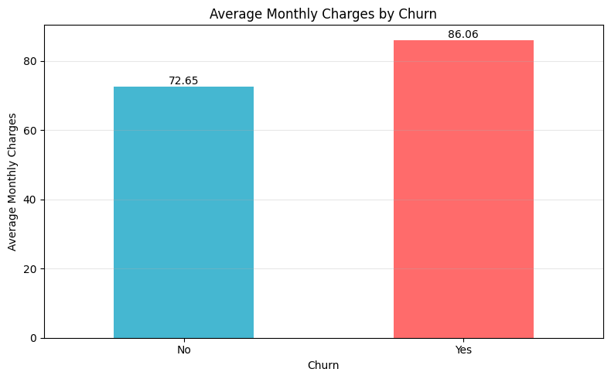
Exploratory Data Analysis
Churn by Contract Type
Monthly: 62.5% churn. 1 Year: 46.2%. 2 Year: 17.4%.
Churn by Satisfaction Score
Scores 1, 3, 5 show 67-69% churn; score 10 shows 29.4%. Pattern is not perfectly smooth.
Avg Monthly Charges by Churn
Churned customers pay more (86.06 vs 72.65) and made more support calls (3.44 vs 2.95).
Notes:
These graphs come from my notebook. Monthly contracts have the highest churn at 62.5 percent, while 2 Year contracts have only 17.4 percent. Customers with low satisfaction scores like 1, 3 and 5 show around 67 to 69 percent churn, but the pattern is not perfectly smooth. Customers who churned also pay more on average and made more support calls.

Slide 6
What is Machine Learning?
Data
Customer records
Algorithm
KNN, Random Forest, etc.
Model
Learned churn patterns
Prediction
Churn: Yes / No
Customer Churn example
Machine Learning allows computers to learn patterns from data and make predictions. Here, the computer learns from past customers (their contract, satisfaction, charges, support calls) and then predicts whether a new customer may leave.
Notes:
Machine Learning lets computers learn patterns from data instead of following fixed rules. We give data to an algorithm, and the algorithm builds a model. The model can then make predictions on new data. In this project, the data is customer records and the prediction is whether a customer will churn.

Slide 7
What is Supervised Learning?
Customer Features
ML Model
Churn
Classification
Predicts a category. Example: Churn = Yes / No.
Regression
Predicts a number. Example: Monthly Charges.
Customer Churn Prediction = CLASSIFICATION
Notes:
Supervised learning means the model learns from data where the correct answer is already known. In my data, every customer already has a Churn label of Yes or No. If the output is a category, it is classification. If the output is a number, it is regression. Since churn is Yes or No, this project is a classification problem.

Slide 8
Classification & Evaluation Metrics
Churn = Yes / No - two classes - Classification problem
Accuracy
Overall correct predictions
Precision
Of predicted churners, how many really churned
Recall
Of actual churners, how many we found
F1 Score
Balance between Precision and Recall
Confusion Matrix
Table of right and wrong predictions (TP, TN, FP, FN)
ROC-AUC
How well the model separates Churn from No Churn
Notes:
Churn has only two outcomes, Yes or No, so this is a classification problem. Accuracy tells the overall correct predictions. Precision tells how many predicted churners really churned, and Recall tells how many actual churners we found. F1 balances Precision and Recall. The confusion matrix shows the right and wrong predictions, and ROC-AUC shows how well the model separates the two classes.

Slide 9
KNN & Decision Tree
KNN - K-Nearest Neighbors
Decision Tree
Feature question?
?
Next question?
Stay
Churn
Stay
Simple illustration
Looks at nearby, similar customers
Notebook uses K = 5 neighbours
Majority vote gives Churn or Stay
Notebook F1 Score: 0.6512
Uses decision rules on features
Splits the data step by step
Easy to understand
Notebook F1 Score: 0.4242
Notes:
KNN looks at the K most similar customers and lets them vote. In my notebook I used K equals 5, so the five nearest customers decide. A Decision Tree asks a series of yes or no questions on the features and splits the data step by step. It is easy to understand, but the tree in my notebook scored lower than KNN.

Slide 10
Random Forest
Tree 1
Customer Data
Tree 2
Combined Prediction
Churn Prediction
Tree 3
Tree 4
Notebook configuration: RandomForestClassifier(n_estimators=100, random_state=42)
Test results: Accuracy 52.78% | Precision 0.5833 | Recall 0.3684 | F1 0.4516 | ROC-AUC 0.6904
Notes:
Random Forest is many decision trees working together. Each tree looks at the customer data and gives its own prediction. The forest combines all the predictions, using a majority vote, to give the final churn prediction. In my notebook I used 100 trees with random state 42.

Slide 11
Bagging & Boosting
BAGGING
Models work independently. Predictions are combined. Example: Random Forest.
Model 1
Model 2
Final Prediction
Model 3
BOOSTING
Models work sequentially. Each model tries to improve previous errors. Examples: AdaBoost, Gradient Boosting.
Model 1
Model 2
Model 3
Final Prediction
"Bagging works independently, while Boosting works sequentially."
Notes:
Both are ensemble learning, which means we combine many models to get a better result. In Bagging, the models work independently and their predictions are combined. In Boosting, the models work one after another, and each new model tries to fix the errors of the previous one. Bagging works independently, while Boosting works sequentially.

Slide 12
AdaBoost & Gradient Boosting
AdaBoost
Adaptive Boosting
Gradient Boosting
Boosting with decision trees
Builds models sequentially
Focuses on difficult observations
Builds models sequentially
Each tree reduces previous errors
Notebook configuration
AdaBoostClassifier(n_estimators=100, random_state=42)
Notebook configuration
GradientBoostingClassifier(n_estimators=100, learning_rate=0.1, max_depth=3, random_state=42)
Test results
Accuracy 61.11% | Precision 0.6923 | Recall 0.4737 | F1 0.5625 | AUC 0.6006
Test results
Accuracy 55.56% | Precision 0.6000 | Recall 0.4737 | F1 0.5294 | AUC 0.6006
Notes:
AdaBoost stands for Adaptive Boosting. It builds models one after another and gives more focus to the difficult customers that earlier models got wrong. Gradient Boosting also builds models sequentially, using decision trees, and each new tree tries to reduce the previous errors. In my notebook AdaBoost had 61.11 percent accuracy and Gradient Boosting had 55.56 percent.

Slide 13
Model Training & Comparison
Model | Accuracy | Precision | Recall | F1 Score | CV Score | Combined
Logistic Regression | 0.6111 | 0.6471 | 0.5789 | 0.6111 | 0.5966 | 0.6053
KNN | 0.5833 | 0.5833 | 0.7368 | 0.6512 | 0.5414 | 0.6073
Decision Tree | 0.4722 | 0.5000 | 0.3684 | 0.4242 | 0.5409 | 0.4709
Random Forest | 0.5278 | 0.5833 | 0.3684 | 0.4516 | 0.5135 | 0.4764
AdaBoost | 0.6111 | 0.6923 | 0.4737 | 0.5625 | 0.5766 | 0.5681
Gradient Boosting | 0.5556 | 0.6000 | 0.4737 | 0.5294 | 0.4796 | 0.5095
CV Score = 5-fold cross-validation accuracy on training data. Combined = 0.6 x F1 + 0.4 x CV Score (used in the notebook to select the final model). Test set = 36 customers.
Notes:
I trained six models: Logistic Regression, KNN, Decision Tree, Random Forest, AdaBoost and Gradient Boosting. All were trained on the same 144 training customers and tested on 36 customers. I compared them with Accuracy, Precision, Recall, F1 and a 5-fold cross-validation score. KNN has the best F1 score, and Logistic Regression has the best cross-validation score.

Slide 14
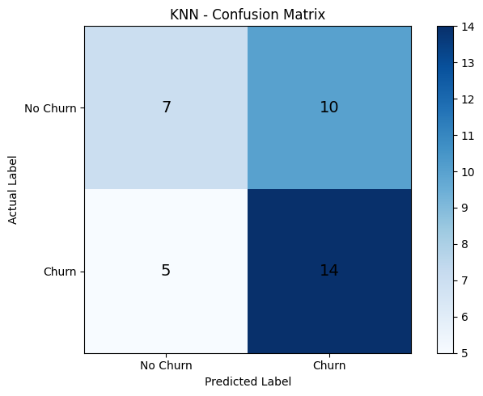
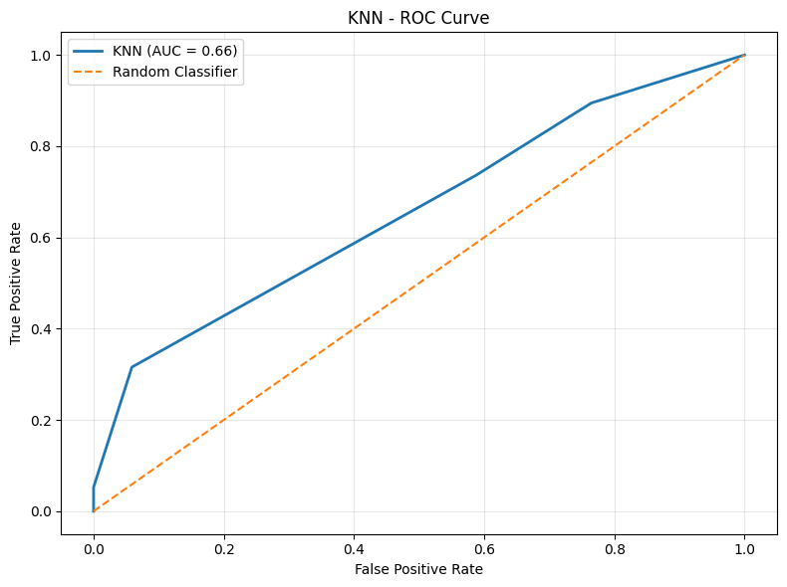
Final Model & Results
KNN (K = 5)
Final model
0.6512
F1 Score
0.5414
CV Score
58.33%
Test Accuracy
0.7368
Recall
0.6563
ROC-AUC
Important features (notebook)
Contract Type, Satisfaction Score, Tenure, Monthly Charges, Support Calls appear useful.
Model errors
False Negatives: 5 (missed churners). False Positives: 10 (predicted churn, but stayed).
Why KNN?
Highest combined score (0.6 x F1 + 0.4 x CV) = 0.6073, chosen on F1 and CV, not accuracy alone.
Notes:
The notebook selects the final model using F1 score and cross-validation. KNN gets the highest combined score of 0.6073, with the best F1 of 0.6512 and a high recall of 0.7368, so it finds most churn customers. Its errors are 10 false positives and 5 false negatives. The overall scores are modest because the dataset is small and messy, so the model should be improved with more data.

Slide 15
Conclusion & Business Recommendations
What we covered
Churn prediction: supervised classification
Data preprocessing and EDA
KNN, Decision Tree, Random Forest
Bagging, AdaBoost, Gradient Boosting
Evaluation: F1, CV, confusion matrix, ROC
Final model: KNN (F1 0.6512)
Recommendations
Target high-risk customers with retention campaigns
Improve customer satisfaction
Monitor customers with frequent support calls
Review contract types and pricing linked to churn
Run the model regularly to spot new risks
Thank You
Notes:
In this project I cleaned a messy churn dataset, explored it, and compared six supervised classification models. KNN was selected as the final model using F1 score and cross-validation. For the business, target high-risk customers, improve satisfaction, monitor support issues and run retention campaigns. The dataset is small, so more data can improve the results. Thank you.

